Slide 1
Introduction to Object Oriented Analysis and Design Basics-Lecture 1
By:
  Ms. Amina Mustansir
  Lecturer PUCIT

Slide 2
Learning Outcomes
What is Analysis?
What is design?
Difference between structured and object oriented approach
Concepts related to object oriented techniques
Object oriented analysis and design
Object Oriented Analysis and Design Basics

Slide 3

Introduction
Teacher
Class
Subject
  Name
  Course outline
  Books
  Project
  Assignments
Object Oriented Analysis and Design Basics

Slide 4
Analysis
Analysis is investigation of problem and requirements, not solution
It is “What customer wants”/”What customer needs”
Analysis best qualified as
  Requirement Analysis
  Object Analysis
Requirements and Specification phases together completes a Analysis Phase
  Requirement Phase compose of preliminary study and domain study
  Specification phase explicitly describes the functionality of the product as well as the constraints attached to it
Object Oriented Analysis and Design Basics

Slide 5
Design
Design is a conceptual solution that fulfills the requirements, not implementation
In general it is “How”
Design best qualified as
  Object design
  Database design
Design is about managing complexity: a design method helps you to split big projects into manageable chunks
Architectural Design and Detailed Design completes a design phase
  Architectural Design is the high level abstraction of the system under consideration, in form of components, their interfaces and relationships.
  Detailed Design is the low level abstraction of each component in detail
Object Oriented Analysis and Design Basics

Slide 6
Analysis and Design can be summarized as; do the right thing (analysis), and do the thing right (Design)
Object Oriented Analysis and Design Basics

Slide 7
Analysis and Design Approaches
Structured Approach
  Action oriented technique
  Data oriented techniques
Object Oriented Approach
  Action oriented techniques and Data oriented techniques are two sides of a coin, captured as one in OO
Object Oriented Analysis and Design Basics

Slide 8
Differences
70 to 80s
80s Onwards
Requirement
Phase
Requirement
Phase
Data Flow Analysis Phase
OO Analysis Phase
Structure Design Phase
OO Design Phase
Structure Programming
OO Programming Phase
Integration & Maintenance
Phase
Integration & Maintenance
Phase
Object Oriented Analysis and Design Basics

Slide 9
Withdraw
Message
Message
Account
Balance
Account
Balance
withdraw
Deposit
Determine
Balance
Deposit
Determine
Balance
Message
Structured paradigm
Object Oriented paradigm
Object Oriented Analysis and Design Basics

Slide 10
Differences between structured paradigm and object oriented paradigm
Structured Paradigm
Object-Oriented Paradigm
Specification (analysis )
  Determine what the product is to do
Design phase
  Architectural design (extract the modules)
  Detailed design
Implementation phase
  Implement in appropriate programming language
Object-oriented analysis phase
  Determine what the product is to do
  Extract the objects
Object-oriented design phase
  Detailed design
Object-oriented programming phase
  Implement in appropriate object-oriented programming language
Object Oriented Analysis and Design Basics

Slide 11
Object Oriented Paradigm
Basic Concepts
  Class
  Object
  Class relationships
  Inheritance
  Polymorphism
  Dynamic binding
Enabling Design Features
  Abstraction/Step wise refinement
  Information hiding
  Cohesion and Coupling
  Decomposition and Modularization
Benefits
  Understandability
  Maintenance
  Independence
  Reusability
}
Data Encapsulation
Object Oriented Analysis and Design Basics

Slide 12
Concepts
Class:
  A class is an abstract data type that supports Inheritance
Object:
  Is an Instance of a class
Object Oriented Analysis and Design Basics

Slide 13
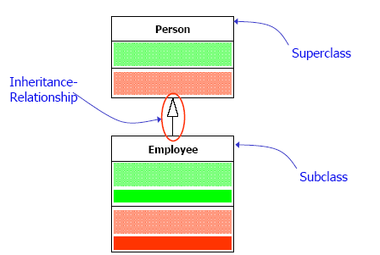
Class relationships
  Specialization/Generalization
Object Oriented Analysis and Design Basics

Slide 14
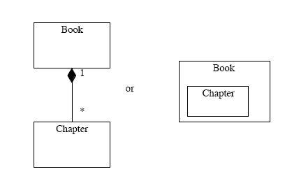
  Association
    Aggregation & Composition
Radiologist
consults
Artist
Association
  Composition
Object Oriented Analysis and Design Basics

Slide 15
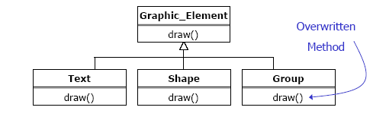
  Polymorphism and Dynamic binding
Object Oriented Analysis and Design Basics

Slide 16
Enabling Design Features
}
  Abstraction/Step wise refinement
  Information hiding
  Cohesion and Coupling
  Decomposition and Modularization
Data Encapsulation
Object Oriented Analysis and Design Basics

Slide 17
Why Object Oriented Design? (Benefits)
Object-oriented systems are easier to maintain as the objects are independent. They may be understood and modified as stand-alone entities.
Changing the implementation of an object or adding services should not affect other system objects.
There is often a clear mapping between real-world entities (such as hardware components) and their controlling objects in the system. This improves the understandability and hence the maintainability of the design.
Objects are potentially reusable components because they are independent encapsulations of state and operations. Designs can be developed using objects that have been created in previous designs. This reduces design, programming and validation costs. It may also lead to the use of standard objects (hence improving design understandability) and reduces the risks involved in software development.
Object Oriented Analysis and Design Basics

Slide 18
What is object oriented Analysis and Design?
Object-oriented analysis, design and programming are all part of object-oriented development where an object-oriented strategy is used throughout the development process:
    Object Oriented Analysis
    Object Oriented Design
Object Oriented Analysis and Design Basics

Slide 19
Object-oriented analysis
Is concerned with developing an object-oriented model of the application domain. The identified objects reflect entities and operations that are associated with the problem to be solved
Object Oriented Analysis and Design Basics

Slide 20
Object-oriented design
Is concerned with developing an object-oriented model of a software system to implement the identified requirements. The objects in an object-oriented design are related to the solution of the problem that is being solved.
Object Oriented Analysis and Design Basics

Slide 21
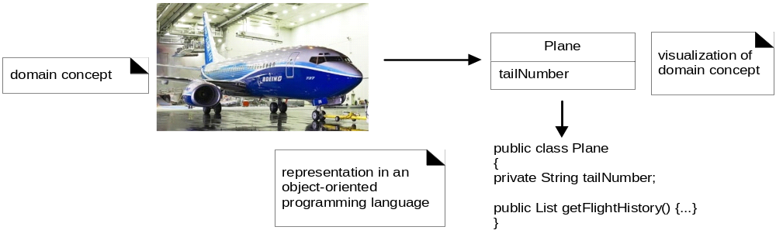
Is concerned with realizing a software design using an object-oriented programming language. An object-oriented programming language supports the direct implementation of objects and provides facilities to define object classes.
Object Oriented Analysis and Design Basics

Slide 22
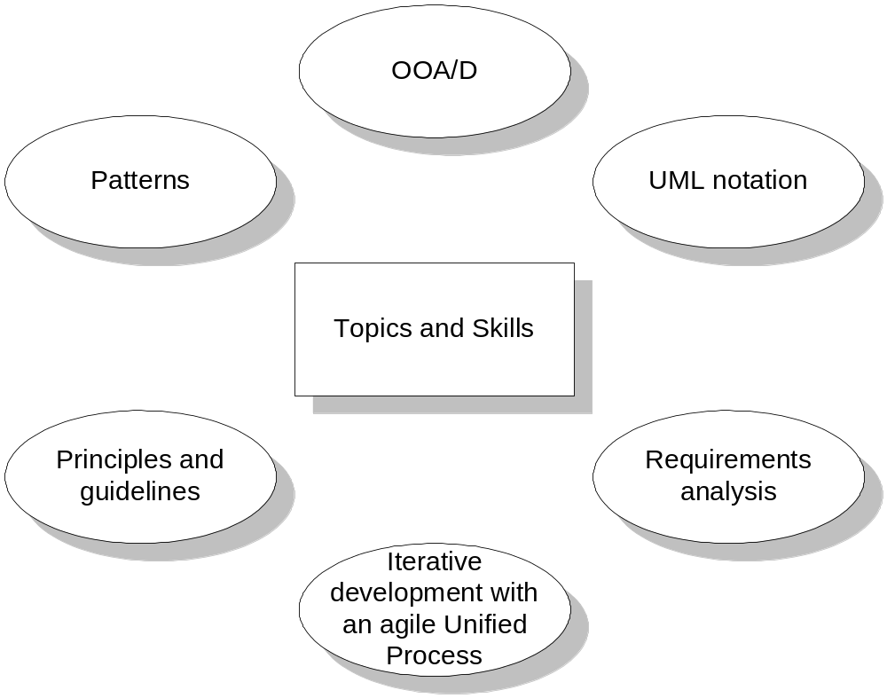
Object Oriented Analysis and Design Basics

Slide 23
Example
A “dice Game”
A player rolls two die. If the total is seven, he wins; other wise he loses
Analysis
Design
Define
Use Cases
Define Domain
Model
Define
Interaction
Diagram
Define Design
Class
Diagram
Object Oriented Analysis and Design Basics

Slide 24
Define Use Cases
Use Cases are not object oriented artifacts. However plays an important role in Unified Process
Play
Use Case: Play
A player picks
up dies and rolls
them
Object Oriented Analysis and Design Basics

Slide 25
Define a Model Diagram
Identification of concepts, attributes and associations
Player
1
2
Die
Rolls
Name
Face value
1
2
Plays
1
DiceGame
1
Includes
Object Oriented Analysis and Design Basics

Slide 26
Define Interaction Diagram
Messages flow between software objects and invocation of methods
:DiceGame
die1:Die
die2: Die
Play()
roll()
GetFaceValue()
roll()
GetFaceValue()
Object Oriented Analysis and Design Basics

Slide 27
Define Design Class Diagram
Attributes and Methods
DiceGame
Die
die1:Die
2
faceValue: int
1
die2:Die
GetFaceVlue(): int
play()
roll()
Object Oriented Analysis and Design Basics

Slide 28
REFERENCES
TEXT BOOK ARTICLE REFFERENCES:
  1.3,1.4,1.5
OTHER REFFERENCES:
  Object-Oriented and Classical Software Engineering by Stephen R Schach
Object Oriented Analysis and Design Basics

